Slide 1

MENTAL HEALTH CARE
Team name:- Codelover77

Slide 2
OVERVIEW
Problem Statement.
Problem Overview.
Proposed Solution.
Objective And Scope.
Characteristic And Feature.
Challenges.
Model Revenue And Market Scope
Technology Implementation

Slide 3
PROBLEM STATEMENT
In the present era, people have started building negative thoughts and emotions and developing stress, anxiety, and depression. To assist, digital solutions offered by therapy apps such as Sanvello, Youper, headspace, etc. Have offered quick conversations, personalized meditations, mood tracking, and health monitoring.
Design a low cost, easy to use, appealing solution that helps people take care of their mental and emotional well-being and help them replace negative thinking patterns with positive ones.

Slide 4
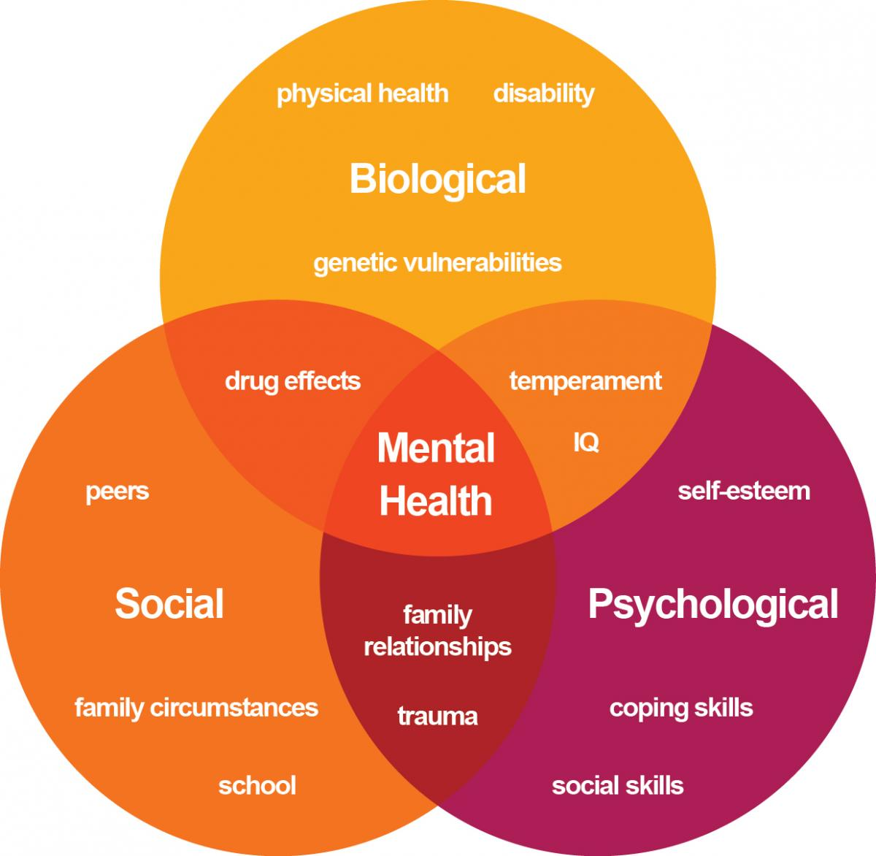
PROBLEM OVERVIEW
DUE TO FOLLOWING FACTORS PROBLEM GENERATED:-
PHYSICAL CAUSES.
SOCIAL AND ENVIORMENTAL CAUSES.
PSYCHOLOGICAL FACTORS.
FAMILY HISTORY.

Slide 5
PROPOSED SOLUTION
We have make a imaginary dataset of human which Calculate The Various Features Like:- Human heartbeat, body monitoring. These datasets are trained & attached to our app(chat bot). This app will use this data to predict human sense and chat with the consultant person about his weakness like negative mindset and give him the positive way while chatting to him. The bot will behave on the basis of data collected over a period of time.

Slide 6
OBJECTIVE AND SCOPE
The main purpose to design this product is:-
It is beneficial for all the member of society.
They have a proper health monitoring on a daily basis.
Costing of the product is low so anyone can purchase it.
It will help to acknowledge the people about their mental health from time to time .
With the product human monitor himself and get good motivated talk with bot like he chat with his friends.
Even they don’t depend on any individual for a just a mood swing.

Slide 7
CHARACTERISTIC,FEATURE AND FUTURE SCOPE.
It will monitor our daily activities and provide us with the accurate details everyday.
It will notify the person if anyone of the task given to him by bot is not completed on time like meditation advice.
It will beep a message of “cool down buddy” whenever the heartbeat will increase rapidly.
It will also play song according to the mood of the person.
Overall with the help of the daily life data chat bot will interact with him according to his mood and do various activities to make him feel light and fluky.
We will make a hardware that user can carry with it and give us accurate data result for further prediction. The hardware is easy to carry like wristband. The idea behind design the hardware is to get the accurate data about the person and consult him carefully.
We will add many mood swing feature, meditation feature and more accuracy result.

Slide 8
CHALLENGES
The main challenge for this product is that it requires more reliable and trusted data so user is not insecure about whether to use it or not.
For this product to applied in real time we have to train the model with data collected from highly skilled psychologist because they better understand mental patient and they have more experience.
The hardware we provide should be reliable in all condition.
In the market there are many apps available for the same purpose but our product is different.

Slide 9
MODEL REVENUE AND MARKET SCOPE
We will start the pitching of product in our Relatives & neighbors which belongs to area of Jaipur.
After a start we will improve our product on the basis of previous feedback.
After that we increase our marketing area to neighbour states which boost the product popularity.
If we got a good ratings by our customer, we will launch it in India else first improve the product, check the quality again and again waiting for ratings till assurance.
We will target the audience of age 18 to 65 years.
We will plan to generate revenue from hardware(required for product)and content marketing or by advertisement.

Slide 10
TECHNOLOGY IMPLEMENT
TECHNOLOGY IMPLEMENTED:- ML AND DATASCIENCE
LANGUAGE USED:- PYTHON
IMAGINARY DATASETS OF HEARTBEATS ,BRAINWAVE AND LIFE ACTIVITIES.
MODULES USED :-KERAS,OPENCV,MATPLOTLIB,PYQT5,NLTK,TENSORFLOW.
THANK YOU

